Slide 1
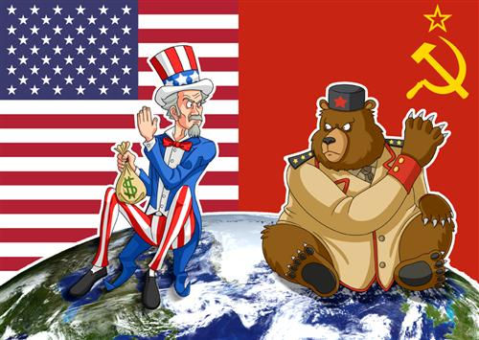
THE COLD WAR

Slide 2
END OF WORLD WAR II
World War 2:
Allies: United States, United Kingdom, Soviet Union, France, China, etc
Axis: Germany, Italy, Japan

Slide 3
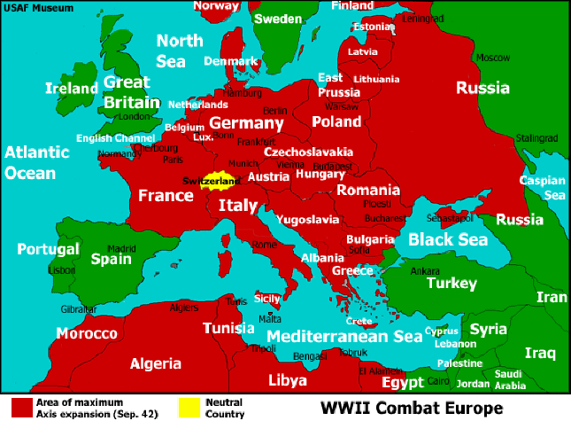
END OF WORLD WAR II

Slide 4
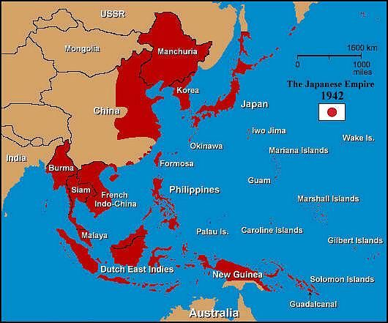
END OF WORLD WAR II

Slide 5
END OF WORLD WAR II
World War 2:
Allies: United States, United Kingdom, Soviet Union, France, China, etc
Axis: Germany, Italy, Japan
Ended in September 1945 with Japan’s surrender after the atomic bombing of Hiroshima and Nagasaki.

Slide 6
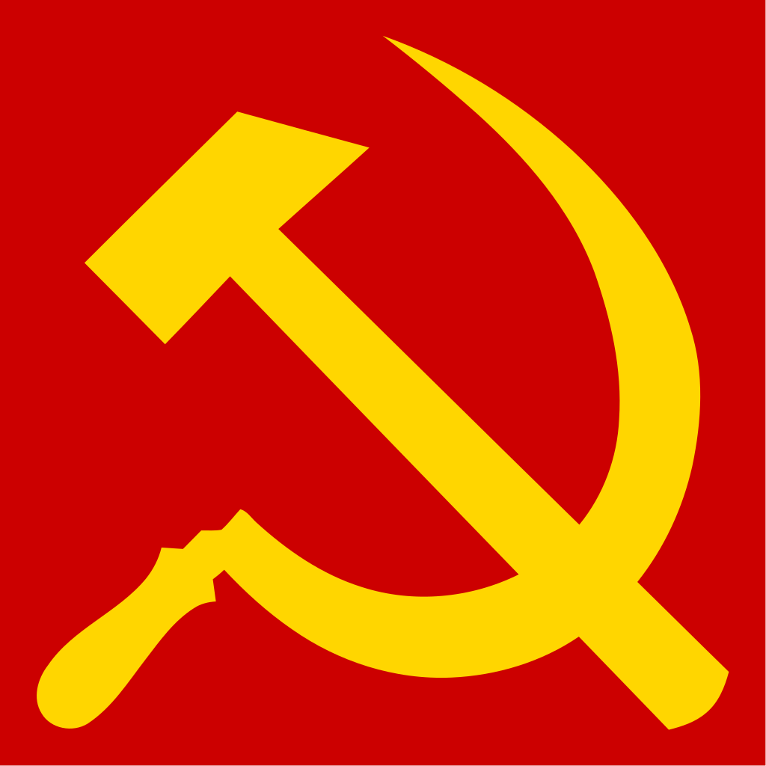
COLD WAR
Communism
Economic and political system that says that the state would own the land, capital, and labor and make all economic decisions.
Usually a dictatorship.
First Communist country: Russia (renamed to the Soviet Union or USSR).

Slide 7
COLD WAR
The Allies of WW2 became enemies:
USA vs USSR
Capitalism vs Communism
Soviets expanded their power by taking over Eastern Europe and establishing satellite nations (countries controlled by another country)
Why a “Cold War?”
No open warfare between US and USSR

Slide 8
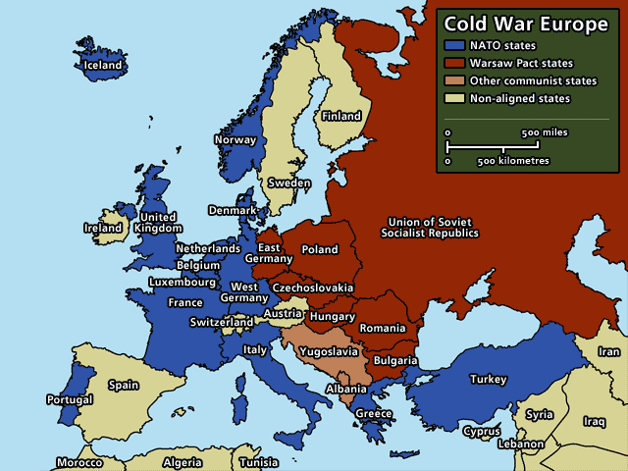
COLD WAR
NATO: North Atlantic Treaty Organization (1949).
Defensive alliance formed by 27 countries, including the United States, Britain, and France, to protect against the Soviet Union.

Slide 9
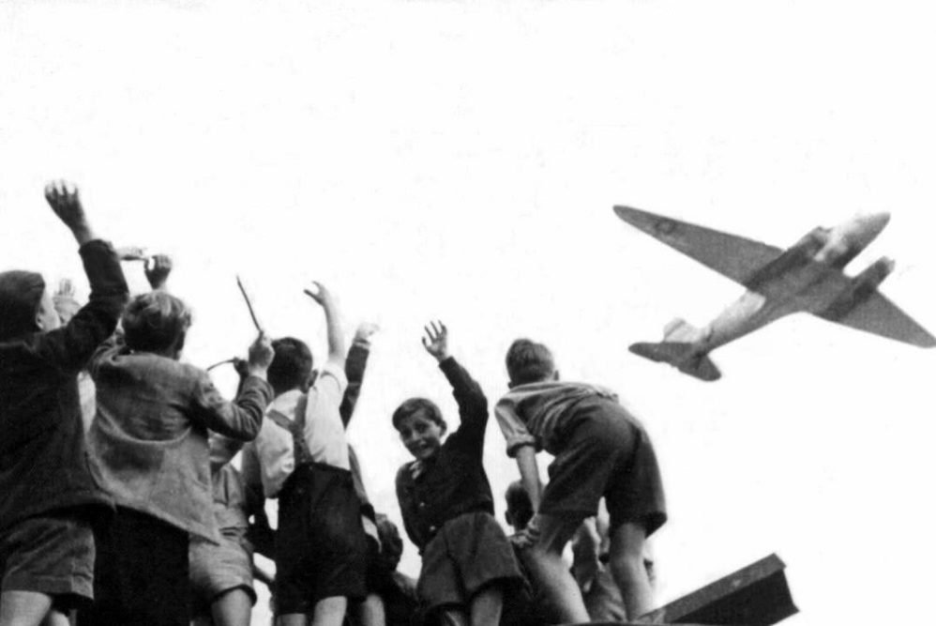
COLD WAR
Containment:
Truman Doctrine
The United States wanted to stop Communism from spreading and to keep the Soviets “contained” to the territory that they held.
1948: Berlin Airlift

Slide 10
COLD WAR
1948: Berlin Airlift
Germany divided into two after WW2; so is Berlin.
Soviet Union tries to force democratic countries from West Berlin.
United States flies in supplies of fuel, food, clothing for over a year.
272,000 flights
2.3 tons of supplies

Slide 11
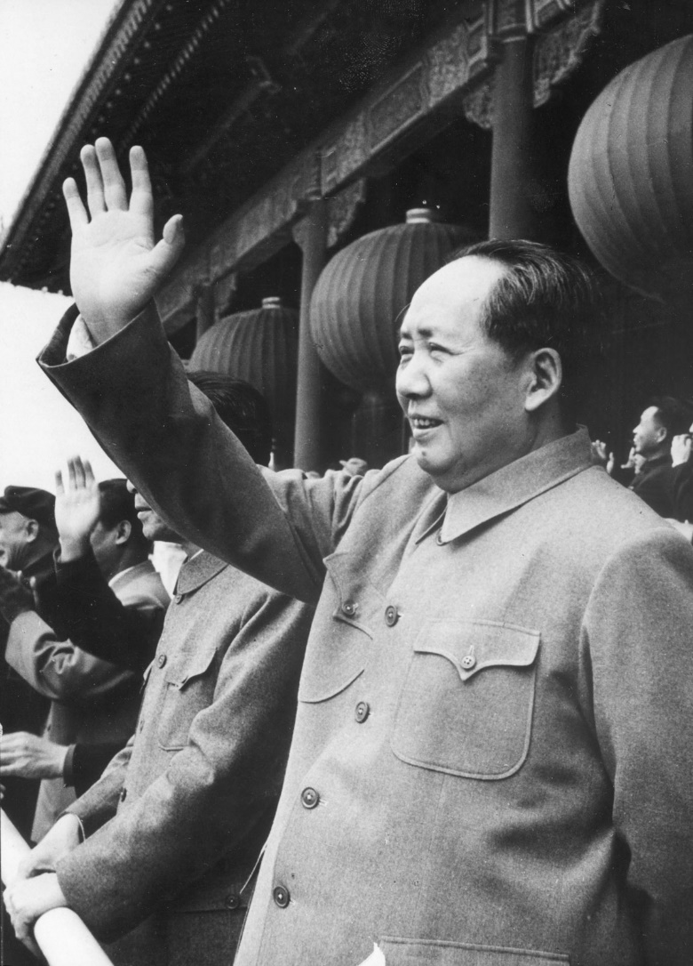
COLD WAR
1949: China becomes Communist
Chinese Civil War: 1945-1949
Mao Zedong: leads the Chinese Communist Revolution
Chinese Nationalists retreat to Taiwan

Slide 12
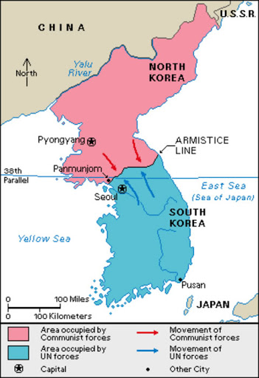
COLD WAR
1950-1953: Korean War
Communist North vs. Capitalist South
Limited War: Fought without using a country’s full power
(No nuclear weapons)
US, China, and others help their allies
War ends in 1953 in stalemate

Slide 13
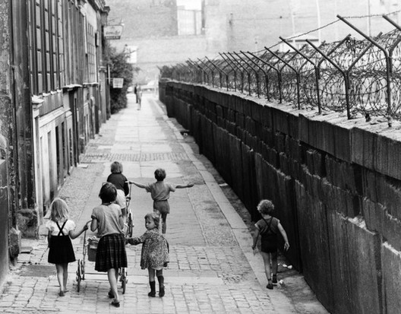
COLD WAR
1961: Berlin Wall constructed
Thousands had been escaping Communist countries through West Berlin.
Communists build a wall overnight to surround West Berlin.
Guards posted to enforce the border.
Border finally re-opened in 1989.

Slide 14
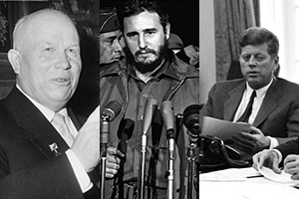
COLD WAR
1962: Cuban Missile Crisis
Soviets building secret missile bases in Cuba
Americans blockade the island; the Cold War almost turns “hot”
Soviets back down
Nikita Khrushchev
Fidel Castro
John F. Kennedy

Slide 15
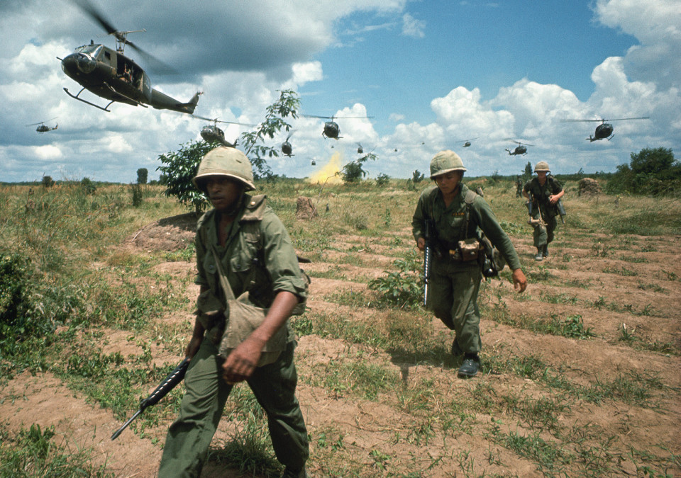
COLD WAR
1950s-1975:
Vietnam War
Communist North
Capitalist South
By 1969: 540,000 American soldiers fighting in Vietnam
Idea of the Domino Theory: if one country falls to Communism, its neighbors may fall too

Slide 16
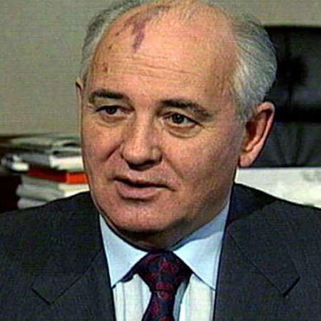
COLD WAR
1970s & 1980s
Détente: a lessoning of tensions
1985: Mikhail Gorbachev becomes leader of Soviets
Introduces reforms that transform Soviet society (glasnost and perestroika)
1991: Soviet Union collapses
Cold War ends

Slide 17
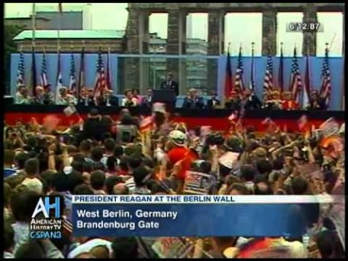
COLD WAR

Slide 18
ASSIGNMENT
Read p. 614-618.
As you read, fill out the timeline on page 1 of the worksheet
Answer the questions on page 2 of the worksheet.

